Slide 1
Tutorial 9
Statistical Computation and Analysis
Spring 2025

Slide 2
Tutorial Outline
Model comparison
Widely applicable information criteria
Cross validation
Model averaging

Slide 3
Model Comparison
How can we compare two or more models for the same data?
We have used posterior predictive checks to assess how well a model explains the data used to fit a model.
We have looked at Bayesian p values.
Now we’ll learn additional methods for comparing between models.

Slide 4
Model Comparison
We aim for:
High goodness of fit
Model fits the data
Lower complexity
Fewer parameters (more parameters can lead to overfitting)
(Occam's razor)
High generalizability
Model predicts future data well

Slide 5
Model Comparison
Important Terms:
Within-sample accuracy :
The accuracy is measured with the same data used to fit the model.
Out-of-sample accuracy :
The accuracy measured with data not used to fit the model.
The within-sample accuracy will be higher and lead us to believe our model is better than it is.
Leaving data out means less data to fit our model.

Slide 6
Model Comparison
To overcome this, we will use two methods:
Information criteria: Expressions that approximate out-of-sample accuracy as in-sample accuracy plus a term that penalizes model complexity.
Cross-validation: A method that involves dividing the available data into separate subsets that are alternatively used to fit and evaluate the models
Notes:
To get out‐of‐sample estimates without permanently carving out a test set, we can use:
Information criteria (e.g. WAIC, formerly DIC) which add a complexity penalty to an in-sample log-likelihood.
Cross-validation, where we repeatedly fit on part of the data and test on the rest.
Both quantify how well a model generalizes without giving away all our data up front.

Slide 7

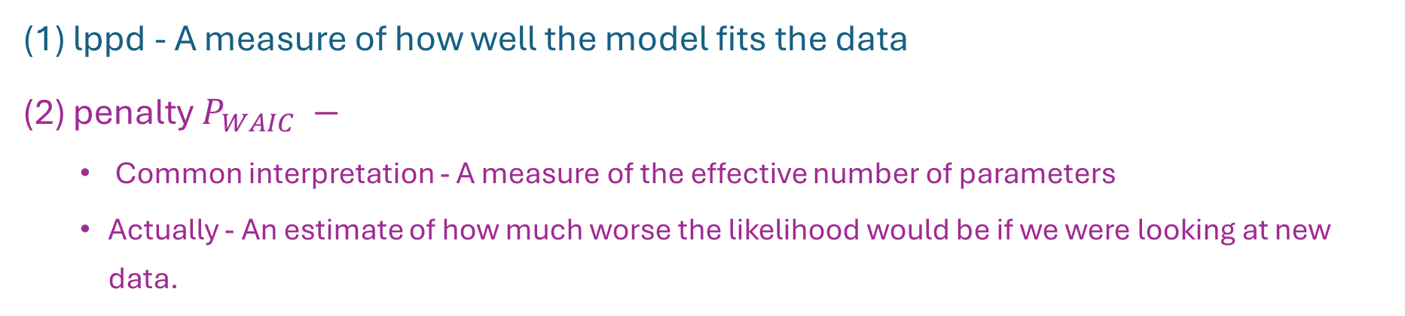

Widely Applicable Information Criteria
Log pointwise predictive density (lppd)
Penalty $P_{WAIC}$
(1) lppd - A measure of how well the model fits the data
(2) penalty $P_{WAIC} −$
Common interpretation - A measure of the effective number of parameters
Actually - An estimate of how much worse the likelihood would be if we were looking at new data.
Notes:
The second - An estimate of how much worse the likelihood would be if we were looking at new data.
Correcting for how much the likelihood would change if I had new data.
Log pointwise predictive density (lppd)
For each observation y_i​, we average its likelihood under each posterior draw, (הסוגריים שבתוך הלוג)
We then take the log, and sum over i=1…n.
Intuitively this estimates how well the model predicts new data “on average.”
Effective number of parameters, pWAIC
For each y_i​, compute the sample variance across draws of its log-likelihood.
Summing these variances gives a measure of model complexity: if the log-likelihood varies a lot between draws, the model is effectively more flexible (has more “parameters”).
Why the −2 and the +2?
The whole criterion is written on the deviance (“–2 log-likelihood”) scale so it’s directly comparable to DIC or AIC.
We pick the model with the smallest WAIC.

Slide 8
Widely Applicable Information Criteria
Log pointwise predictive density (lppd)
Penalty $P_{WAIC}$
We will choose the model with the lower WAIC.
If two models fit the data equally well, we will choose the simpler one.
Notes:
The second - An estimate of how much worse the likelihood would be if we were looking at new data.
Correcting for how much the likelihood would change if I had new data.

Slide 9
Cross Validation
Divide our data into k parts.
Use k-1 parts to fit the model and test it on the left-out portion.
We get k models and k accuracy values.
The accuracy of the model is the average of the k accuracy values.
Fit the model on all the data one final time.
This is the final model for future use.

Slide 10
Cross Validation
When K equals the number of data points, we get what is known as leave-one-out cross validation (LOOCV), meaning we fit the model to all but one data point each time.
Practically, this is computationally expensive, and we are going to estimate it.

Slide 11
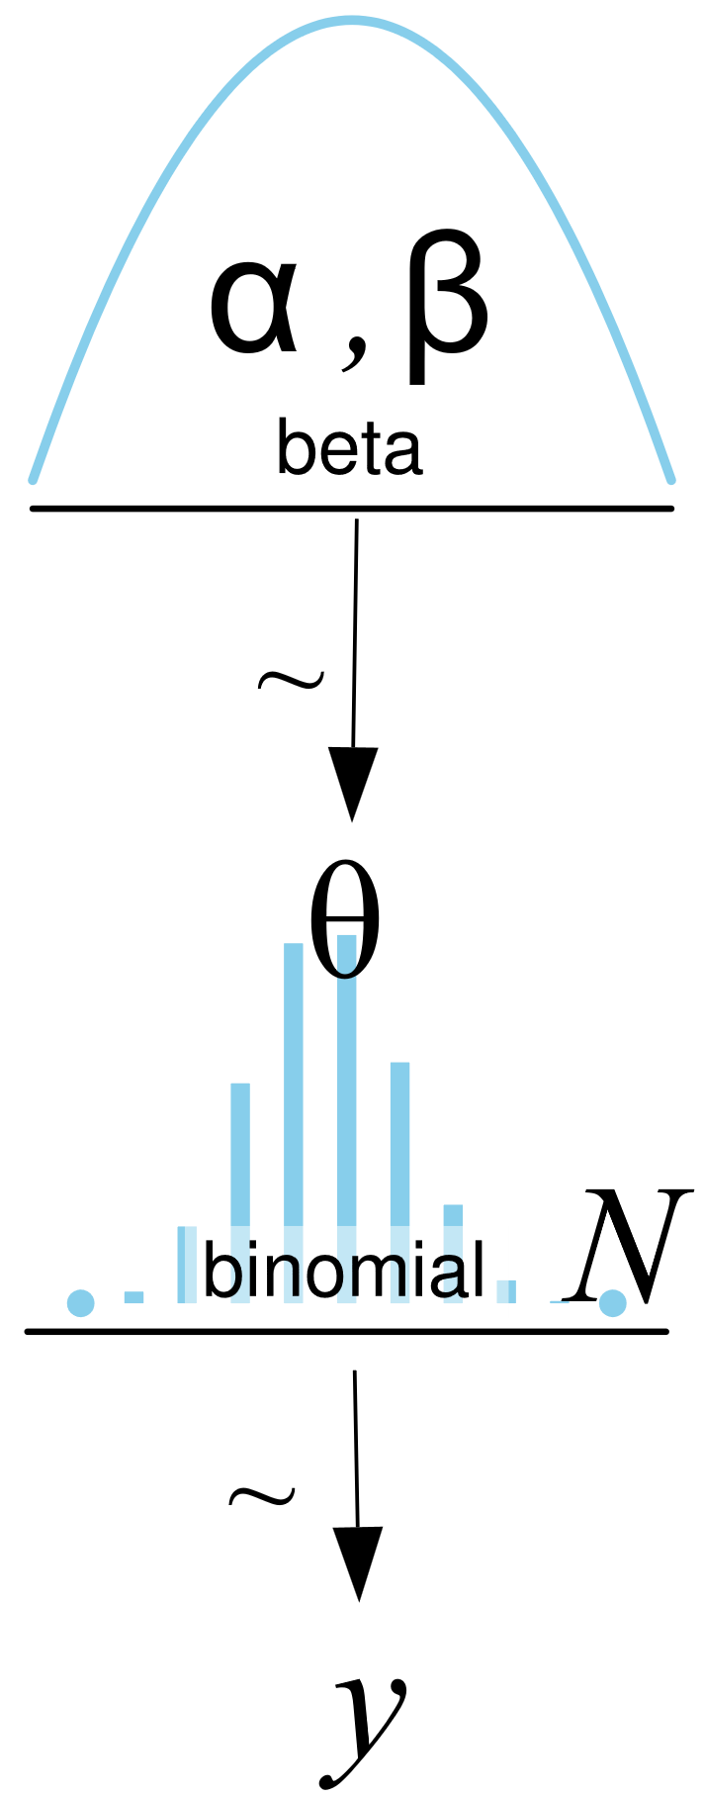
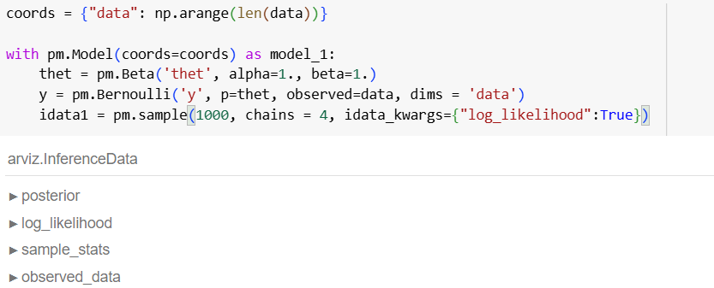
Null and Alternative Model
Null model: coin is fair.
Alternative model: coin is biased.
Graphical model
PyMC (a PPL)
Notes:
Reminder – we can always reject the null hyposis but can never accept the alternative

Slide 12
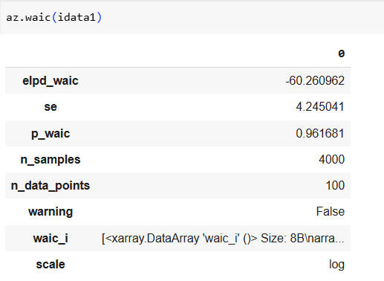
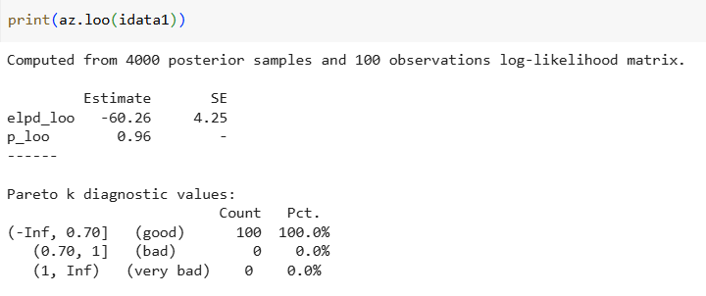
Null and Alternative Model
First, let’s look at the WAIC and LOO of our model:
Now let’s compare the values to those of the null model.
Effective number of parameters
How reliable is our estimate?
Values above 0.7 indicate that we may have very influential datapoints – bad.
We can see that 100% of our datapoints are good.

Slide 13
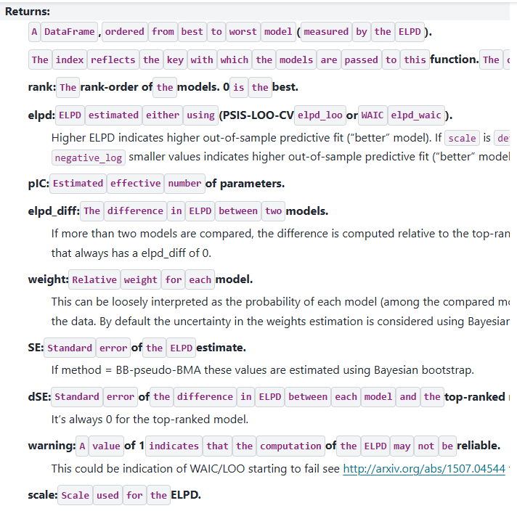
az. compare
https://python.arviz.org/en/stable/api/generated/arviz.compare.html
Notes:
Rank – The rank-order of the models. 0 is the best.
ELPD - Higher ELPD indicates higher out-of-sample predictive fit (“better” model). If scale is deviance or negative_log smaller values indicates higher out-of-sample predictive fit (“better” model).
ELPD Diff – The difference in ELPD between two models. If more than two models are compared, the difference is computed relative to the top-ranked model, that always has a elpd_diff of 0.
SE - Standard error of the ELPD estimate. If method = BB-pseudo-BMA these values are estimated using Bayesian bootstrap.
dSE – Standard error of the difference in ELPD between each model and the top-ranked model. It’s always 0 for the top-ranked model.
*elpd stands for Expected Log Pointwise Predictive Density. It is a measure of how well a model is expected to predict new (held-out) data, computed by summing the log-predictive densities for each data point.

Slide 14

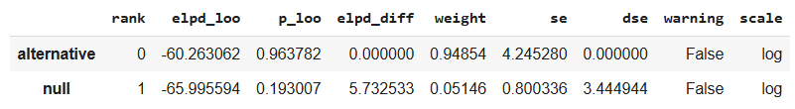
Null and Alternative Model
From best to worst
Higher = better
If the difference between the elpd values is bigger
than the standard error
Then we say that there is a meaningful difference between the two models

Slide 15
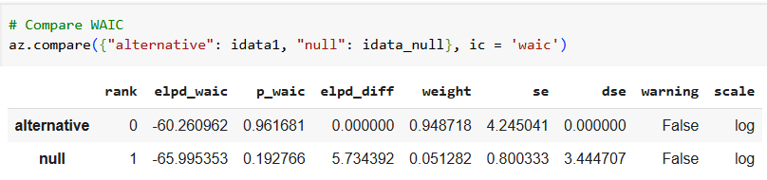
Null and Alternative Model
That was the LOO values, now we can do the same with the widely accepted information criteria.
The WAIC and LOO values are generally almost exactly the same.
At this point, it is generally more accepted to use the LOO.

Slide 16
Null and Alternative Model
We created the null model by using a very narrow posterior defined by the ROPE.
We defined the ROPE as [0.45, 0.55].
Another option for comparison is to check if the HDI and ROPE overlap.
Based on our model comparison using LOO and WAIC, we concluded that there is a meaningful difference between the null and alternative models.

Slide 17
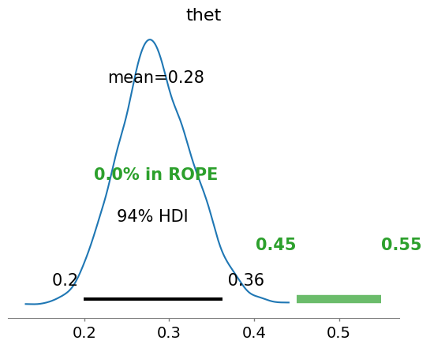
Null and Alternative Model
We arrive at the same conclusion looking at the HDI and ROPE
There is no overlap between them
We reject the null model of a fair coin

Slide 18
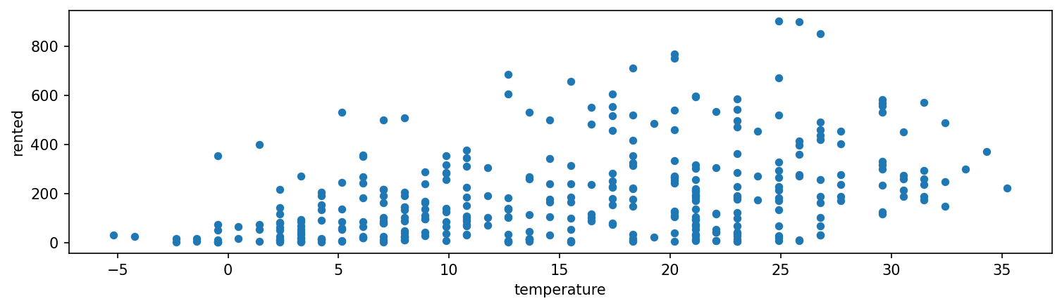
Bikes Example
In the lecture, you looked at bike rentals as a function of temperature using several models:

Slide 19
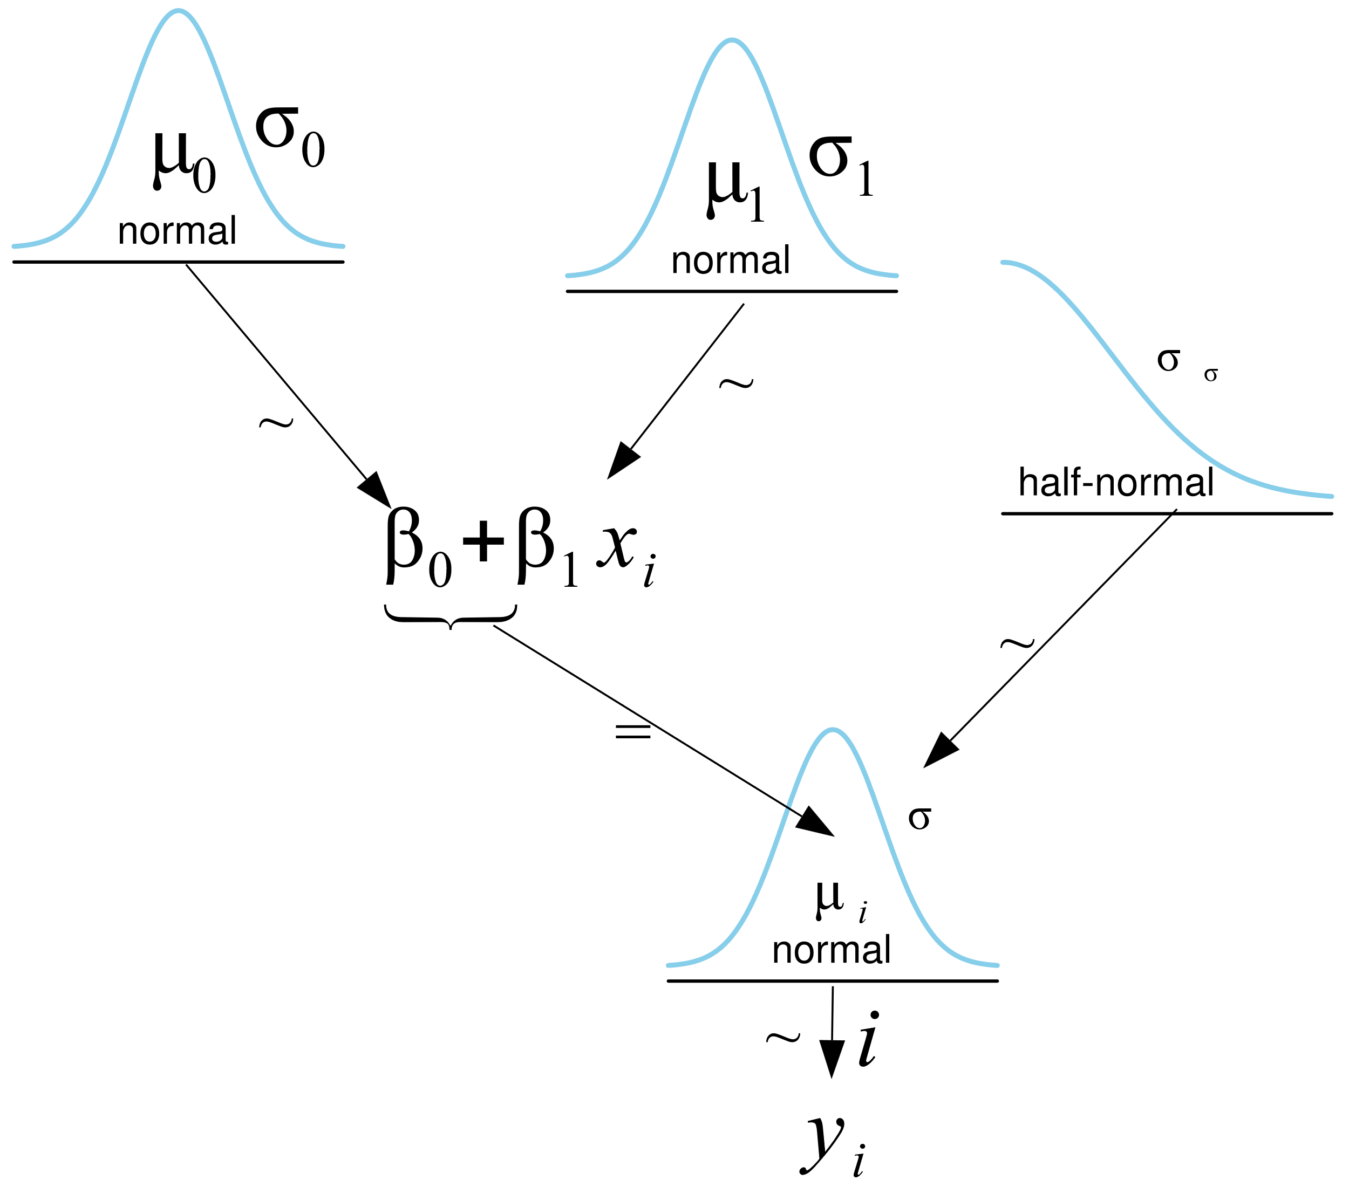
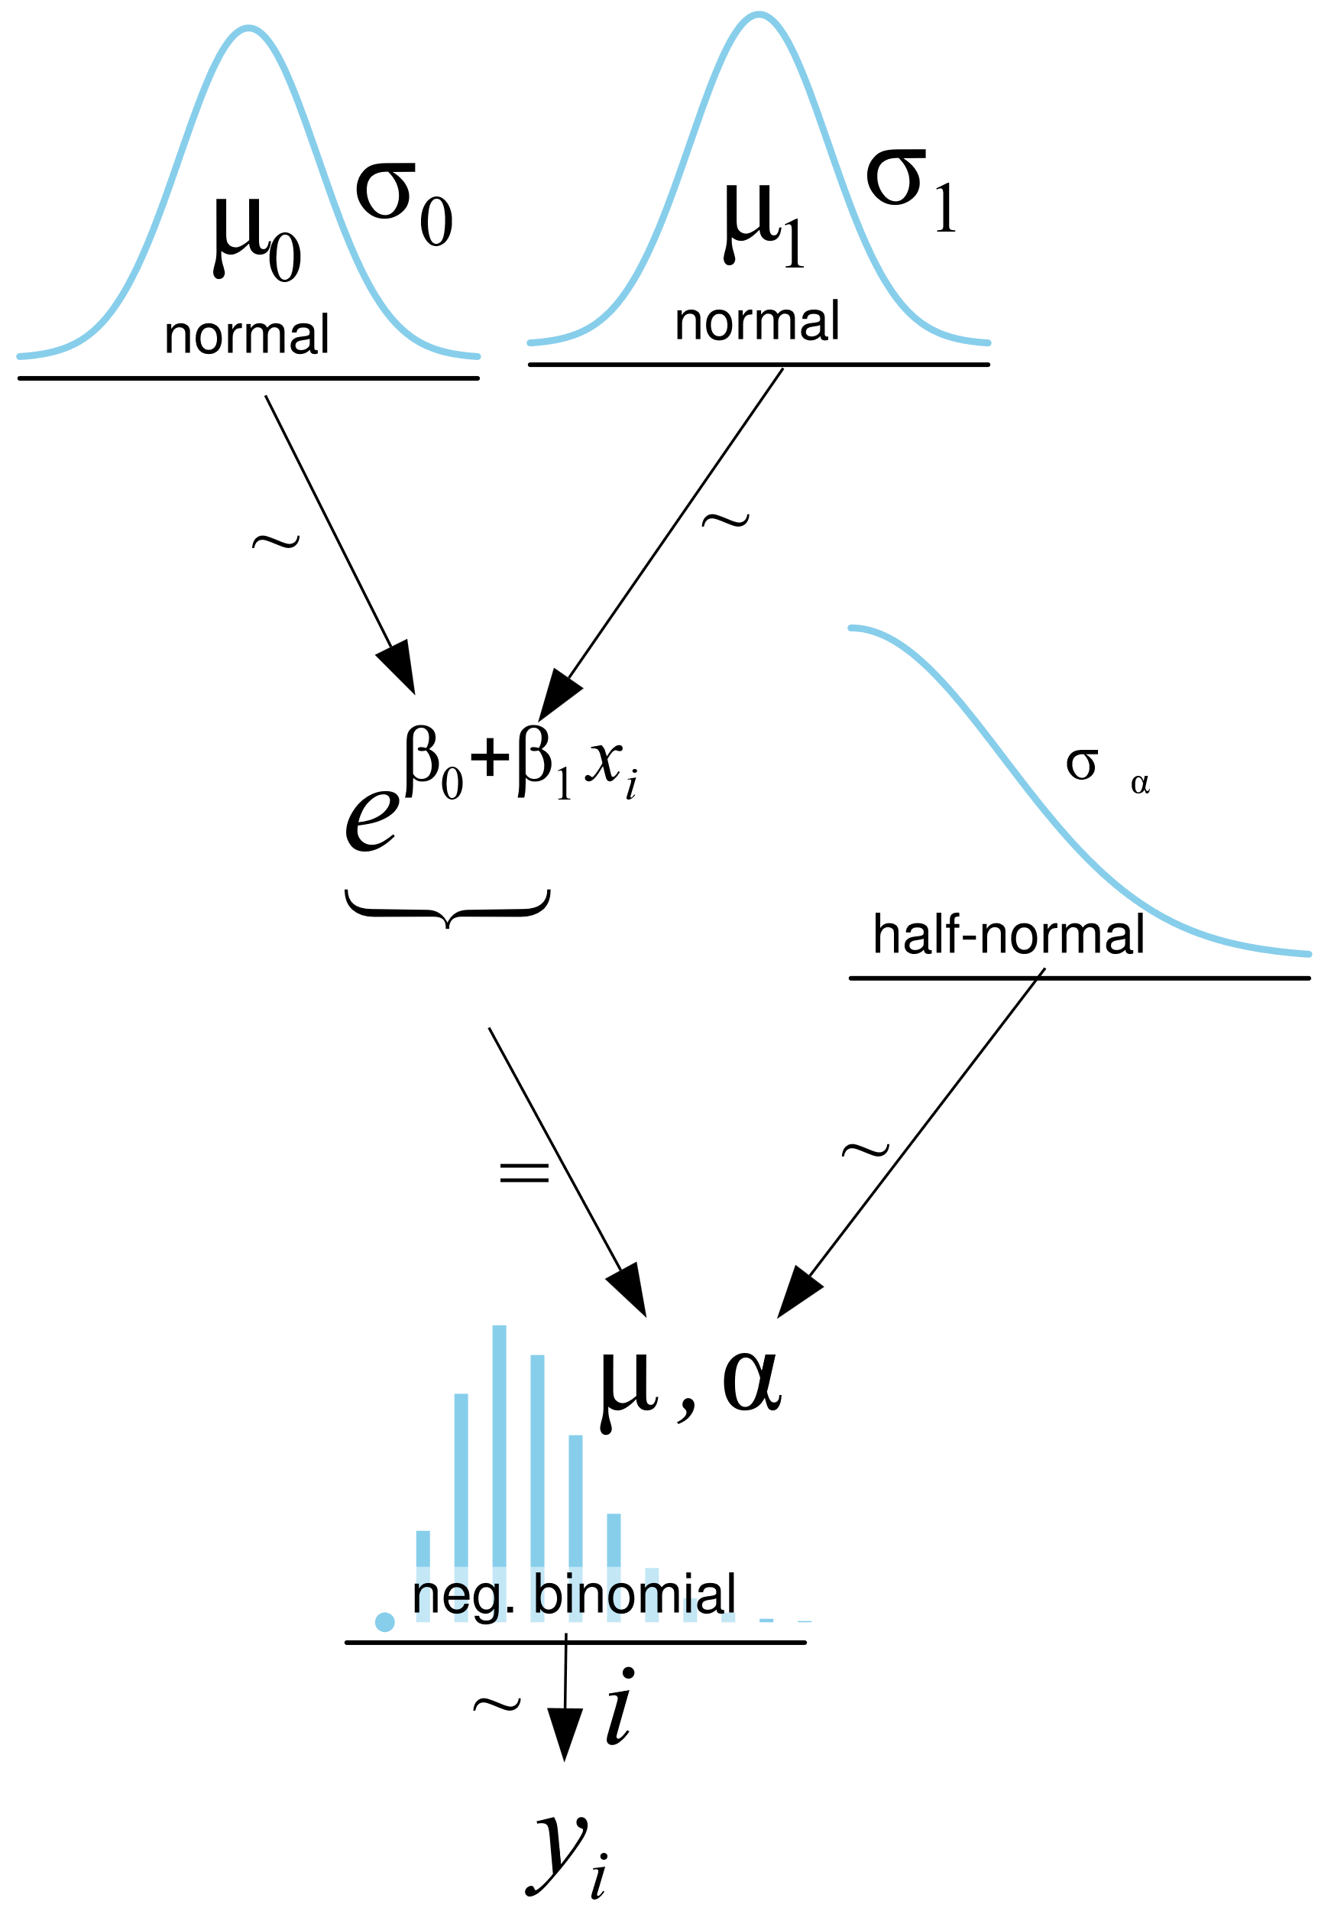
Bikes Example
In the lecture, you looked at bike rentals as a function of temperature using two models:
Linear Model
Negative Binomial Model

Slide 20
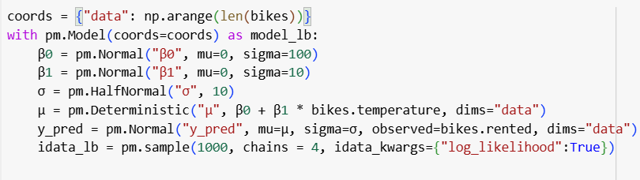
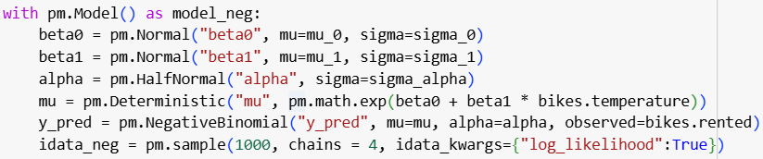
Bikes Example
In the lecture, you looked at bike rentals as a function of temperature using two models:
Linear Model
Negative Binomial Model

Slide 21
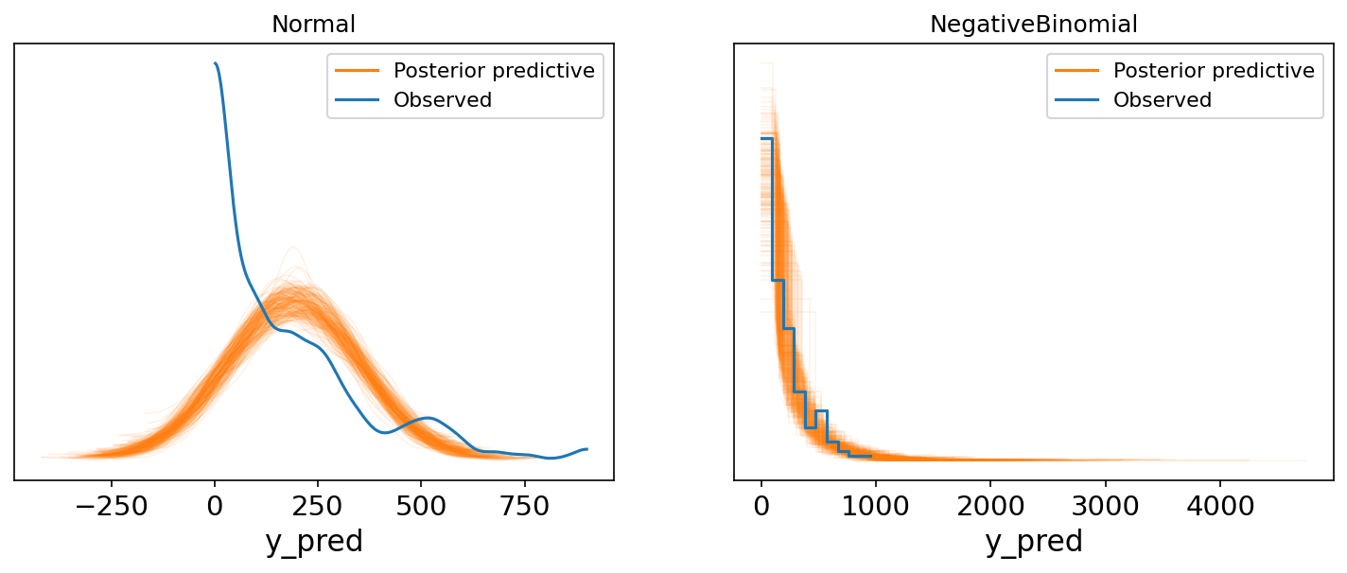
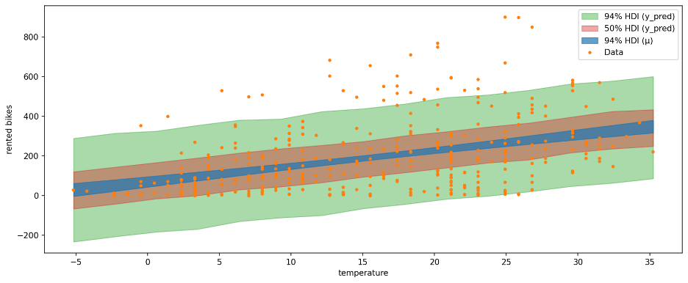
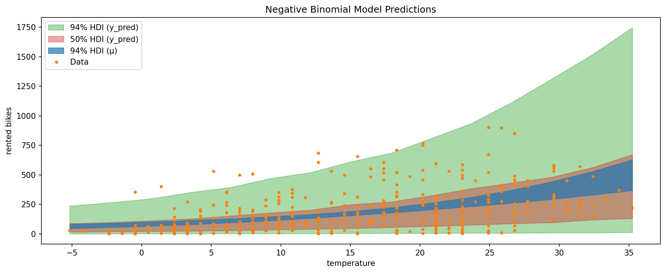
Bikes Example
In the lecture you compared the two using posterior predictive checks and saw that the negative binomial model was better:

Slide 22
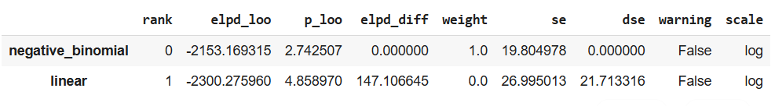
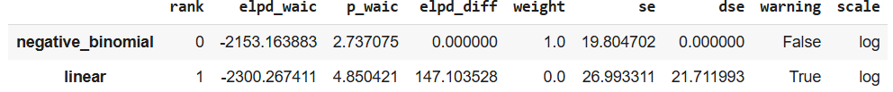
Bikes Example
Let’s add the WAIC and LOO to the comparison:

Slide 23
Bikes Example
We also learned about multiple regression.
Another use for model comparison can be to test the value of adding additional independent variables.
Adds information to the model.
Adds complexity.
We can add another independent variable of the humidity of the day.

Slide 24
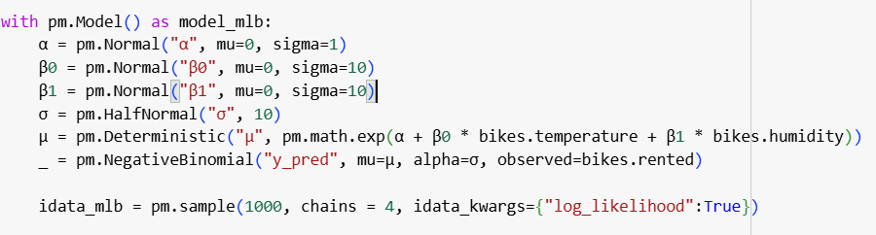
Bikes Example
Create and sample:

Slide 25
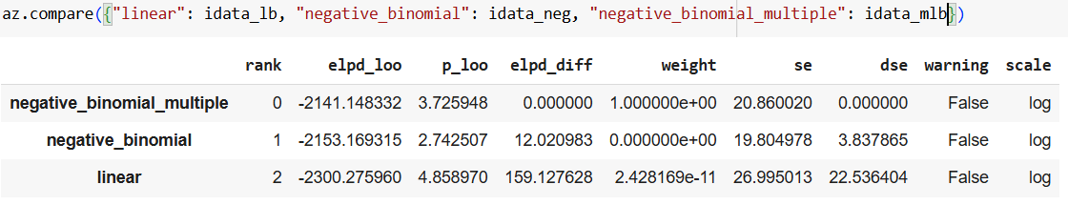
Bikes Example
Now let’s compare all three:
We can see that the difference between the LOO values for the two negative binomial models is larger than the standard error.
We can conclude from this that it is worth adding the humidity despite it leading to a more complex model.

Slide 26

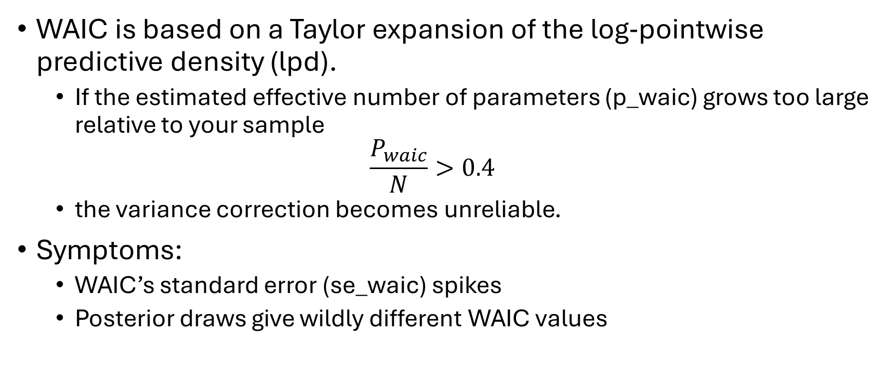
When can’t we trust WAIC?
WAIC is based on a Taylor expansion of the log‐pointwise predictive density (lpd).
If the estimated effective number of parameters (p_waic) grows too large relative to your sample
$$\frac{P_{waic}}{N}>0.4$$
the variance correction becomes unreliable.
Symptoms:
WAIC’s standard error (se_waic) spikes
Posterior draws give wildly different WAIC values
https://python.arviz.org/en/latest/api/generated/arviz.waic.html
Notes:
https://python.arviz.org/en/latest/api/generated/arviz.waic.html

Slide 27
When can’t we trust LOO?
LOO uses Pareto-smoothed importance sampling to approximate refits.
Key diagnostic: the Pareto shape parameters k from loo.pareto_k.
Rule of thumb:
If any K > 0.1 sampling variance infinite → don’t trust LOO
If more than ~5% of points have K > 0.7 → beware
Symptoms:
LOO se is huge
Repeated reruns give different ranking

Slide 28
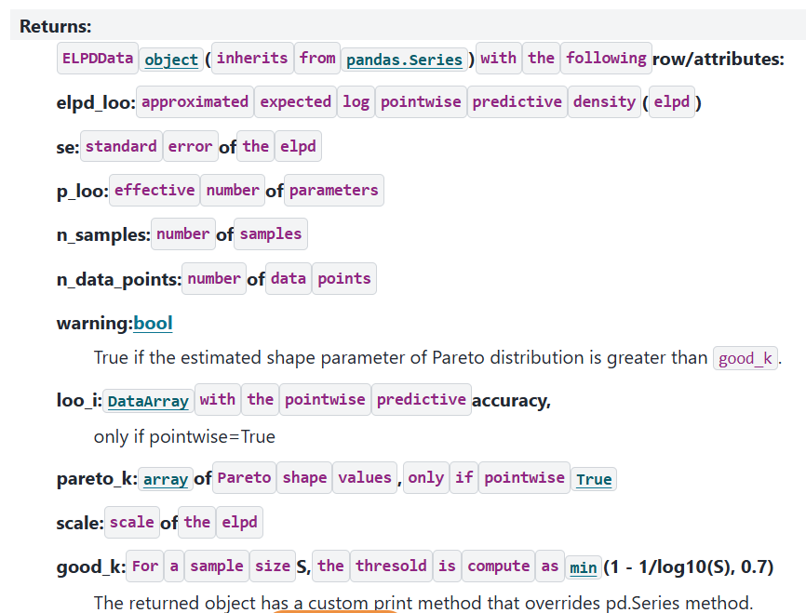
When can’t we trust LOO?
https://arxiv.org/abs/1507.04544 https://arxiv.org/abs/1507.02646

Slide 29
Model Averaging
Instead of choosing one model, we can also average the different models.
We can compute a weighted average of the different models.
The weights are computed in the compare function.
They are the relative weight of each model and, in large, represent the probability of each model given the data.

Slide 30
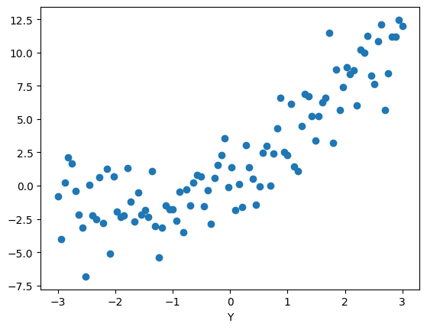
Model Averaging
Let’s create random data with two models that give not zero weights.
We’ll use a linear model
Simpler but fits data less well
And a quadratic model
Fits better but more complex

Slide 31
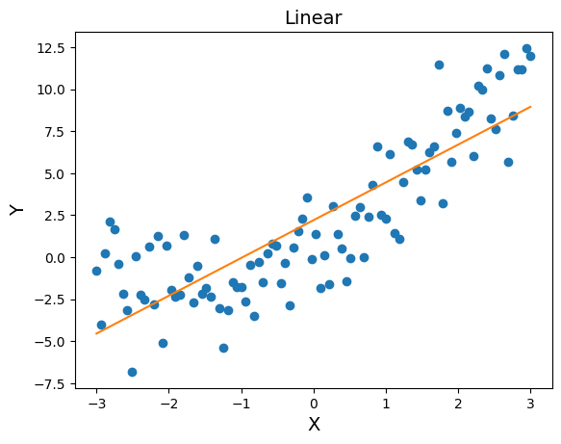
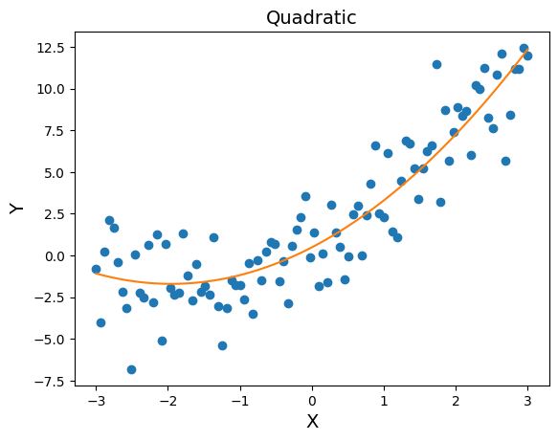
Model Averaging
The means of the two models:

Slide 32
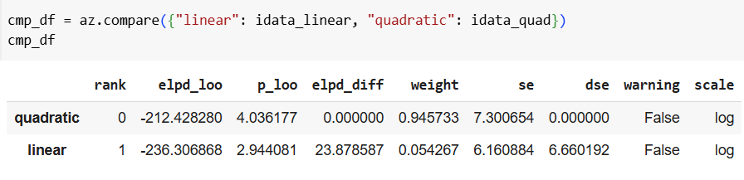
Model Averaging
Comparing between them yields:
We will use these weights to compute the weighted average model.

Slide 33
Model Averaging
Comparing between them yields:
We will use these weights to compute the weighted average model.

Slide 34
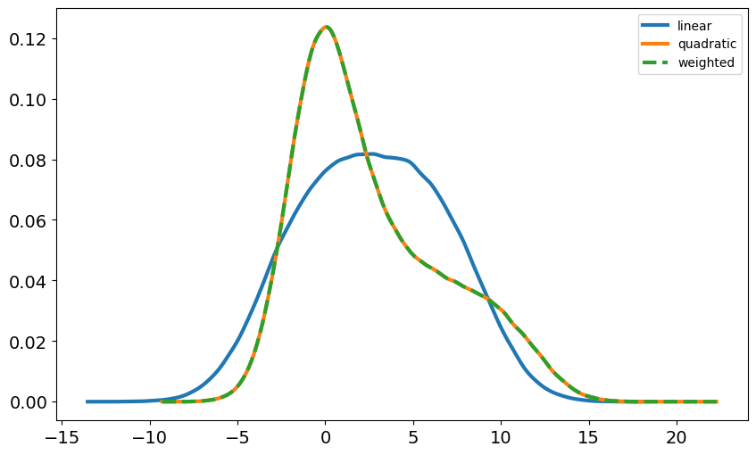
Model Averaging
Plotting:

Slide 35
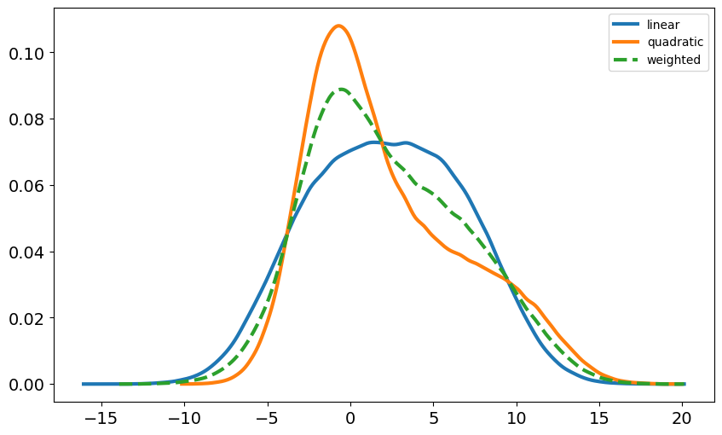
Model Averaging
We can also define the weights however we like.
Example: half to each of the two models.

